Slide 1
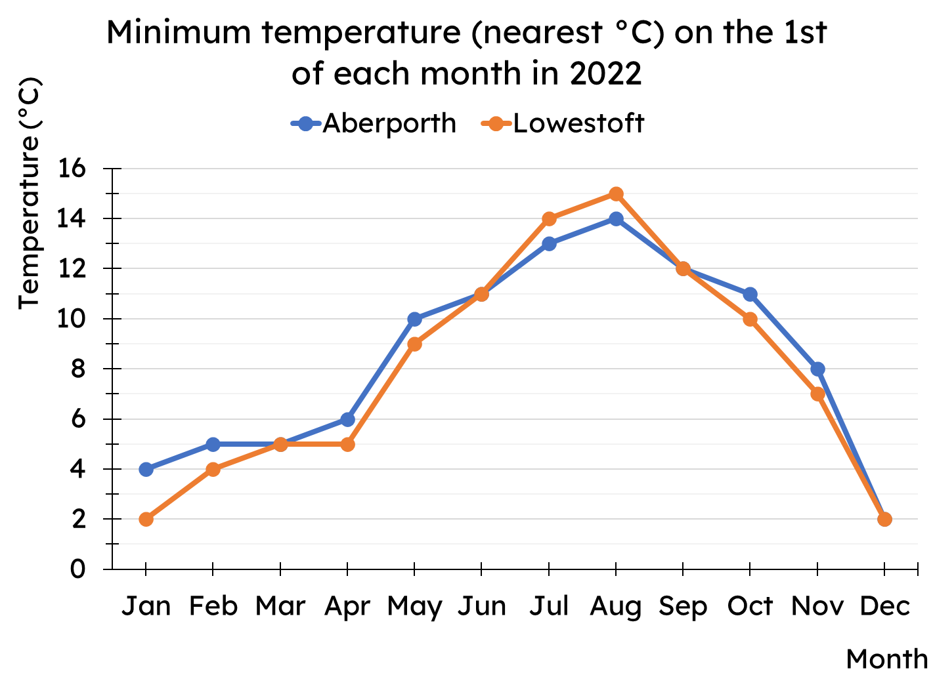
Calculating the median
Task A: Median from a line graph
Work out the median minimum temperature for both Aberporth and Lowestoft.
Task B: Median from an ungrouped frequency table
1) Complete the missing frequencies.
star rating | frequency
1
2 | 25
3
4 | 54
5 | 31
star rating | frequency
1 | 16
2 or less | 41
3 or less
4 or less | 129
5 or less | 160
2) Work out the median for these data sets
a)
goals scored | frequency
0 | 12
1 | 27
2 | 43
3 | 37
4 | 10
b)
tube lines | frequency
1 | 204
2 | 53
3 | 19
4 | 5
5 | 3
6 | 1
c)
For each of your answers to parts a and b, justify why your answers are sensible.

Slide 2
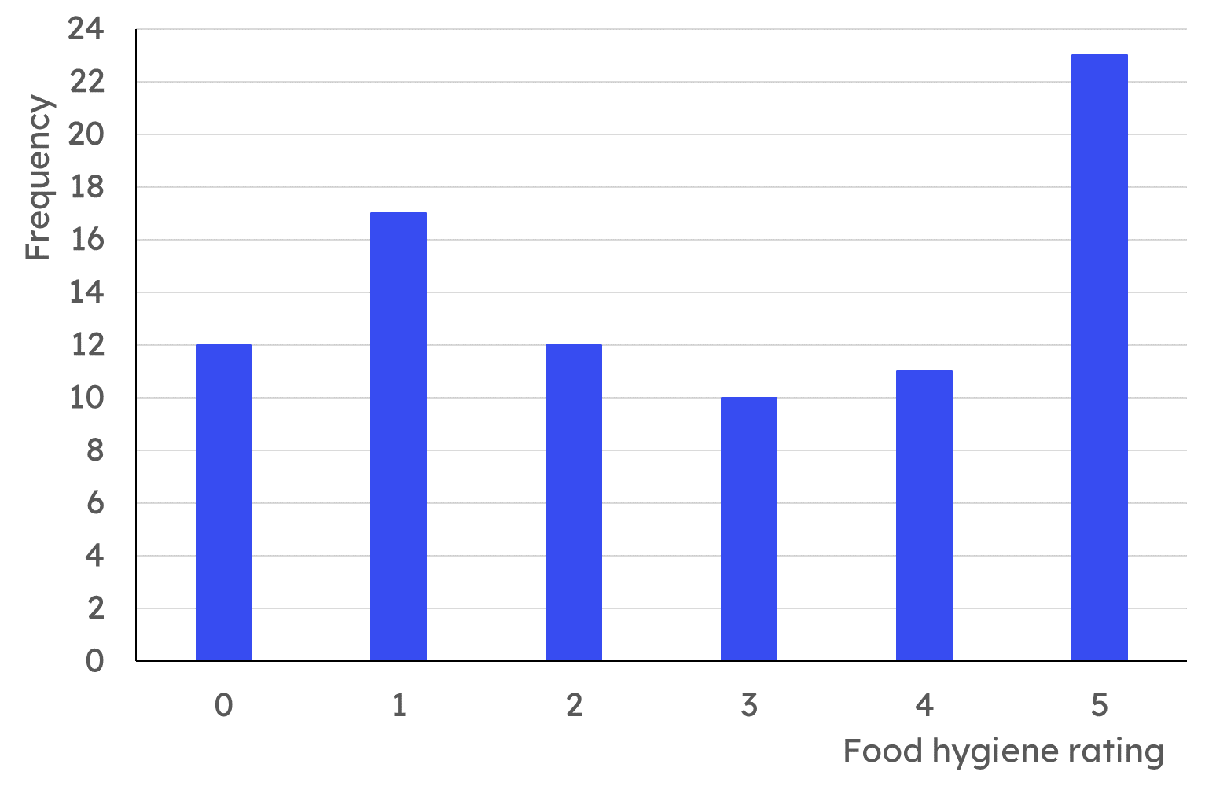
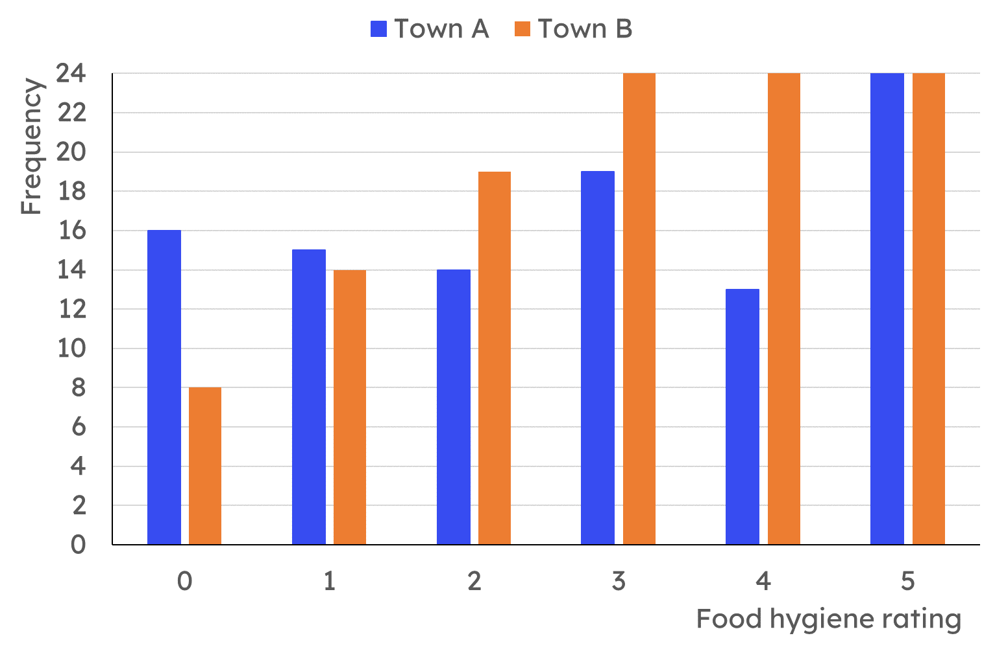
Calculating the median
Task C: Median from a bar chart
Here is a bar chart showing the food hygiene ratings for a group of local restaurants.
How many restaurants is this data about?
What is the position of the median?
What is the median food hygiene rating?
Here is a bar chart showing the food hygiene ratings for restaurants in two towns. Calculate the median food hygiene rating for each town.
Mathematics in Education and Industry
v2.1

